Slide 1
Lesson 3 python programming
Sets, Dictionaries and Functions

Slide 2
Objective
Sets: Union, Intersection, Difference
Dictionaries: Update, Delete, Add
Functions
Web scraping
Notes:
2

Slide 3
SETS

Slide 4
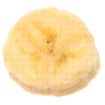
Sets
Set: object that stores a collection of data in same way as mathematical set
All items must be unique
Set is unordered
Elements can be of different data types
Sets are immutable, eg:
>>> aset = {11, 22, 33}
>>> bset = aset
>>> aset = aset | {55}
>>> aset {33, 11, 22, 55}
>>> bset {33, 11, 22}

Slide 5
Creating a Set
set function: used to create a set
For empty set, call set()
For non-empty set, call set(argument) where argument is an object that contains iterable elements
{'Alice', 'Bob', 'Carol'}
{'Dean'} is a singleton
argument can be a list, string, or tuple
If argument is a string, each character becomes a set element
If argument contains duplicates, only one of the duplicates will appear in the set

Slide 6
Getting the Number of and Adding Elements
len function: returns the number of elements in the set
>>> myset = {'Apples', 'Bananas', 'Oranges'}
>>> len(myset) → 3
add method: adds an element to a set
>>> myset.add(‘strawberry’)
>>>print(myset) -> {'Apples', 'Bananas', 'Oranges’, ‘strawberry’}
update method: adds a group of elements to a set
Argument must be a sequence containing iterable elements, and each of the elements is added to the set
>>> myset.update(‘1’,’2’)
>>>print(myset) -> {'Apples', 'Bananas', 'Oranges’,’1’,’2’}

Slide 7
Deleting Elements From a Set
Remove and discard methods: remove the specified item from the set
The item that should be removed is passed to both methods as an argument
Behave differently when the specified item is not found in the set
remove method raises a KeyError exception
discard method does not raise an exception
>>> myset.remove(‘Apples’)
>>>print(myset) -> {'Bananas', 'Oranges’)}
clear method: clears all the elements of the set

Slide 8
Using the for Loop, in, and not in Operators With a Set
A for loop can be used to iterate over elements in a set
General format: for item in set:
The loop iterates once for each element in the set
The in operator can be used to test whether a value exists in a set
Similarly, the not in operator can be used to test whether a value does not exist in a set

Slide 9
Sets do not support indexing
>>> myset = {'Apples', 'Bananas', 'Oranges'}
>>> myset {'Bananas', 'Oranges', 'Apples'}
>>> myset[0] Traceback (most recent call last): File "<pyshell#2>", line 1, in <module> myset[0] TypeError: 'set' object does not support indexing

Slide 10
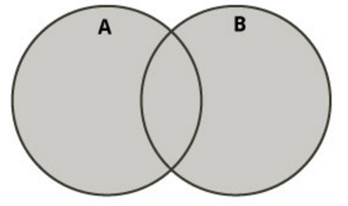
Boolean operations on sets (I)
Union of two sets
Contains all elements that are in set A or in set B
>>> aset = {11, 22, 33}
>>> bset = {12, 23, 33}
Union of two sets
>>> aset | bset {33, 22, 23, 11, 12}

Slide 11
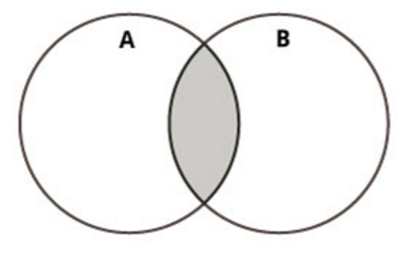
Intersection of two sets
Intersection of two sets
Contains all elements that are in both sets A and B
>>> aset = {11, 22, 33}
>>> bset = {12, 23, 33}
Intersection of two sets:
>>> aset & bset {33}

Slide 12
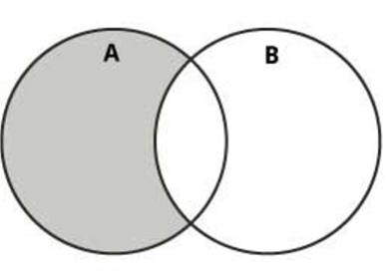
Boolean operations on sets (III)
Difference of two sets
Contains all elements that are in A but not in B
>>> aset = {11, 22, 33}
>>> bset = {12, 23, 33}
Difference:
>>> aset – bset {11, 22}

Slide 13
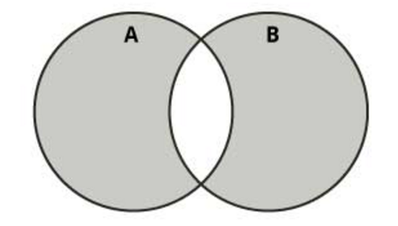
Boolean operations on sets (IV)
Symmetric difference of two sets
Contains all elements that are either
in set A but not in set B or
in set B but not in set A
>>> aset = {11, 22, 33}
>>> bset = {12, 23, 33}
Symmetric difference:
>>> aset ^ bset {11, 12, 22, 23}

Slide 14
DICTIONARIES

Slide 15
Dictionaries (I)
A dictionary is a container that keeps associations between keys and values.
Keys are unique, but a value may be associated with several keys.
Keys
Values
John
$15,000
Ann
$12,000
Mike
Mary
$30,000

Slide 16

Creating Dictionaries
Each key/value pair is separated by a colon.
You enclose the key/value pairs in braces,
To create an empty dictionary:
Use {}
Use built-in function dict()
Use a for loop to iterate over a dictionary
General format: for key in dictionary:

Slide 17
Sets and dictionaries
When the braces contain key/value pairs, they denote a dictionary, not a set.
The only ambiguous case is an empty {}. By convention, it denotes an empty dictionary, not an empty set.
You can create a duplicate copy of a dictionary using the dict function: oldSalaries = dict(salaries)
salaries = { “John": 15000, “Ann": 30000, “Mike": 12000, “Mary": 15000 }

Slide 18
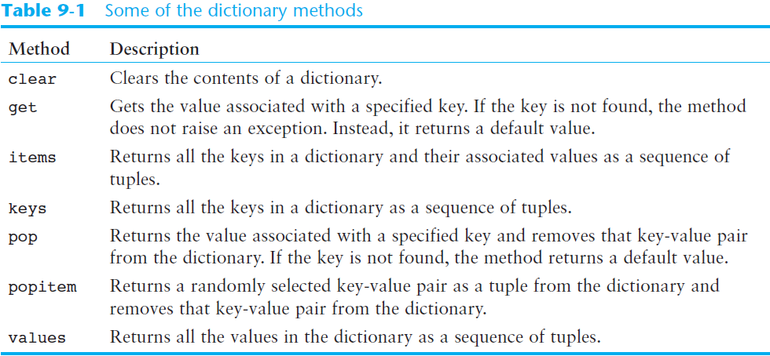
Some Dictionary Methods (cont’d.)

Slide 19
Accessing Dictionary Values
The subscript operator [] is used to return the value associated with a key.
The statement: print(“Ann’s salary is", salaries[“Ann"]) prints 3000
Note that the dictionary is not a sequence-type container like a list.
Even though the subscript operator is used with a dictionary, you cannot access the items by index or position. A value can only be accessed using its associated key

Slide 20
Searching For Keys
The key supplied to the subscript operator must be a valid key in the dictionary or a KeyError exception will be raised.
To find out whether a key is present in the dictionary, use the in (or not in) operator: if “Ann" in salaries : print(“Ann’s salary is", salaries[“Ann”]) else : print(“Ann’s salary is not in my list.”)

Slide 21
Default Value
Often, you want to use a default value if a key is not present. For example, if there is no salary for Mike, you want to get an average salary instead.
Instead of using the in operator, you can simply call the get method and pass the key and a default value. The default value is returned if there is no matching key. number = salaries.get(“Mike", 17000) print(“Salary: " + number)

Slide 22
Dictionaries are mutable
>>> age = {'Alice' : 25, 'Bob' : 28}
>>> saved = age
>>> age['Bob'] = 29
>>> age {'Bob': 29, 'Alice': 25}
>>> saved {'Bob': 29, 'Alice': 25}

Slide 23
Adding Elements to an Existing Dictionary
To add a new key-value pair:
dictionary[key] = value
If key exists in the dictionary, the value associated with it will be changed

Slide 24
Displaying contents
>>> age = {'Alice' : 25, 'Carol': 'twenty-two'}
>>> age.items() dict_items([ ('Alice', 25), ('Carol', 'twenty-two')])
>>> age.keys() dict_keys([ 'Alice', 'Carol'])
age.values() dict_values([28, 25, 'twenty-two'])

Slide 25
Updating dictionaries
>>> age = {'Alice': 26 , 'Carol' : 22}
>>> age.update({'Bob' : 29})
>>> age {'Bob': 29, 'Carol': 22, 'Alice': 26}
>>> age.update({'Carol' : 23})
>>> age {'Bob': 29, 'Carol': 23, 'Alice': 26}

Slide 26
Returning a value
>>> age = {'Bob': 29, 'Carol': 23, 'Alice': 26}
>>> age.get('Bob') 29
>>> age['Bob'] 29

Slide 27
Removaing a specific item (I)
>>> a = {'Alice' : 26, 'Carol' : 'twenty-two'}
>>> a {'Carol': 'twenty-two', 'Alice': 26}
>>> a.pop('Carol’) 'twenty-two’
>>> a {'Alice': 26}

Slide 28
Remove a random item
>>> age = {'Bob': 29, 'Carol': 23, 'Alice': 26}
>>> age.popitem() ('Bob', 29)
>>> age
{'Carol': 23, 'Alice': 26}
>>> age.popitem() ('Carol', 23)
>>> age {'Alice': 26}

Slide 29

Avoiding Removal Errors
If the key is not in the dictionary, the pop method raises a KeyError exception.
To prevent the exception from being raised, you can test for the key in the dictionary: if "Mike" in salaries : salaries.pop("Mike")

Slide 30
Getting the Number of Elements and Mixing Data Types
len function: used to obtain number of elements in a dictionary
clear method: deletes all the elements in a dictionary, leaving it empty
Format: dictionary.clear()
Values stored in a single dictionary can be of different types

Slide 31

Different Ways Of Doing The Same Thing
Lists
prerequisites = [“COP 2271c”, “Introduction to Computation and Programming”, 3]
- print(prerequisites[2]) # Prints the element at index 2
Sets
cheesePizza = {“Creamy garlic”, “Parmesan sauce”, “Cheese”, “Toasted Parmesan”}
if "Toasted Parmesan" in cheesePizza :
Dictionaries
salaries = {"John": 15000, "Ann": 30000, "Mike": 12000, "Mary": 15000 }
print("Ann’s salary is", salaries["Ann"])

Slide 32
Python Functions
A function is a piece of code that performs a task of some kind.
A function has a name that is used when we need for the task to be executed. Asking that the task be executed is referred to as “calling” the function.
Some functions need one or more pieces of input when they are called. Others do not.
Some functions give back a value; others do not. If a function gives back a value, this is referred to as “returning” the value.

Slide 33
Defining Functions
Function definition begins with “def.”
Function name and its arguments.
def get_final_answer(filename):
“““Documentation String””” line1
line2
return total_counter
The indentation matters…
First line with less indentation is considered to be outside of the function definition.
The keyword ‘return’ indicates the value to be sent back to the caller.

Slide 34
Calling a Function
The syntax for a function call is:
>>> def myfun(x, y):
return x * y
>>> myfun(3, 4)
12
Parameters in Python are Call by Assignment
Old values for the variables that are parameter names are hidden, and these variables are simply made to refer to the new values
All assignment in Python, including binding function parameters, uses reference semantics.

Slide 35
Functions without returns
All functions in Python have a return value, even if no return line inside the code
Functions without a return return the special value None
None is a special constant in the language
None is used like NULL, void, or nil in other languages
None is also logically equivalent to False
The interpreter’s REPL doesn’t print None

Slide 36
Function overloading? No.
There is no function overloading in Python
Unlike C++, a Python function is specified by its name alone
The number, order, names, or types of arguments cannot be used to distinguish between two functions with the same name
Two different functions can’t have the same name, even if they have different arguments

Slide 37
Default Values for Arguments
You can provide default values for a function’s arguments
These arguments are optional when the function is called
>>> def myfun(b, c=3, d=“hello”): return b + c
>>> myfun(5,3,”hello”)
>>> myfun(5,3)
>>> myfun(5)
All of the above function calls return 8

Slide 38
Keyword Arguments
Can call a function with some/all of its arguments out of order as long as you specify their names
>>> def foo(x,y,z): return(2*x,4*y,8*z)
>>> foo(2,3,4)
(4, 12, 32)
>>> foo(z=4, y=2, x=3)
(6, 8, 32)
>>> foo(-2, z=-4, y=-3)
(-4, -12, -32)
Can be combined with defaults, too
>>> def foo(x=1,y=2,z=3): return(2*x,4*y,8*z)
>>> foo()
(2, 8, 24)
>>> foo(z=100)
(2, 8, 800)

Slide 39
Python and Types
Dynamic typing: Python determines the data types of variable bindings in a program automatically
Strong typing: But Python’s not casual about types, it enforces the types of objects
For example, you can’t just append an integer to a string, but must first convert it to a string
x = “the answer is ” # x bound to a string
y = 23 # y bound to an integer.
print x + y # Python will complain!

Slide 40
Functions are first-class objects
Functions can be used as any other datatype, eg:
Arguments to function
Return values of functions
Assigned to variables
Parts of tuples, lists, etc
>>> def square(x): return x*x
>>> def applier(q, x): return q(x)
>>> applier(square, 7)
49

Slide 41
Web Scraping
a computer software technique of extracting information from websites. (Wikipedia)
for business, hobbies, research...
Look for right URLs to scrap.
Look for right content from webpages.
Saving data into data store.

Slide 42
BeautifulSoap library
Python third-party library for extracting data from html and xml files
Works with html.parser, lxml, html5lib
Provides ways to navigate, search and modify the parse tree based on the position in the parse tree, tag name, tag attributes, css classes using regular expressions, userdefined functions etc
Excellent tutorial with examples at http://www.crummy.com/software/BeautifulSoup/bs4/doc/
Supports Python 2.7 and 3

Slide 43
Installation
pip install beautifulsoup4 or easy_install beautifulsoup4
See: http://www.crummy.com/software/BeautifulSoup/
On installing libraries: http://docs.python.org/2/install/

Slide 44
Open a page
soup = BeautifulSoup(html_doc)
Print all: print(soup.prettify())
Print text: print(soup.get_text())

Slide 45
Navigating the Page Structure
some sites use div, others put everything in tables

Slide 46
Find all
finds all the Tag and NavigableString objects that match the criteria you give.
find table rows: find_all("tr")
e.g.: for link in soup.find_all(’a’): print(link.get(’href’))

Slide 47
Basic functions: Getting headers, titles, body
soup.head
soup.title
soup.body

Slide 48
Simple example(1)
import Requests
from bs4 import BeautifulSoup
html = requests.get("http://sampleshop.pl")
bsObj = BeautifulSoup(html.content, "html.parser")
print(bsObj.h1)

Slide 49
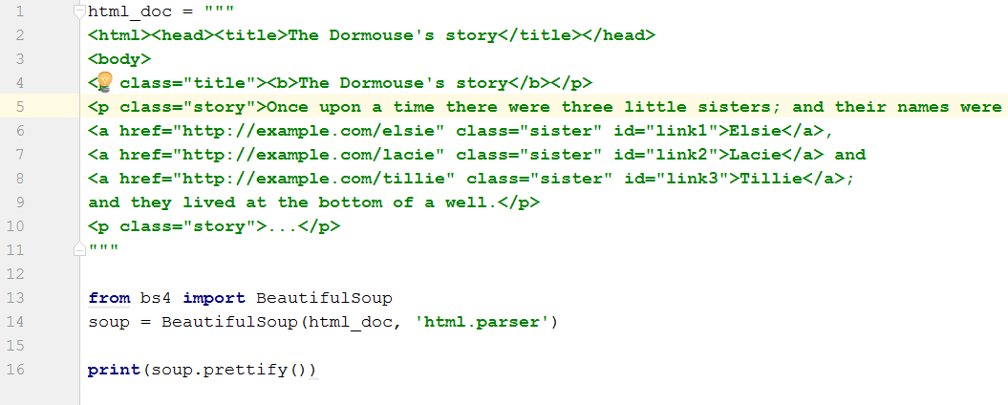
An example with html(2)

Slide 50
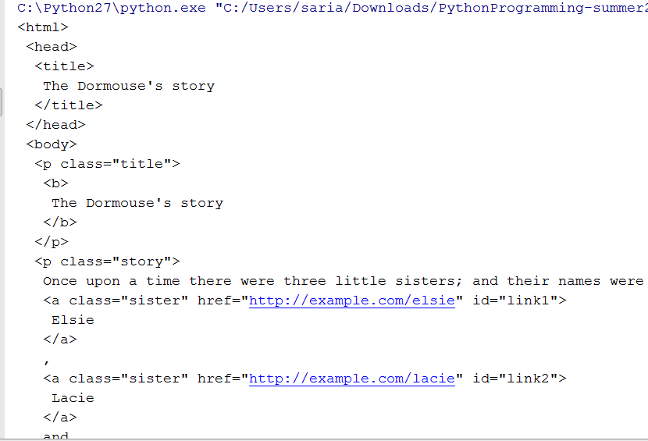
Output of the previous code

Slide 51


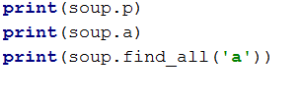


simple ways to navigate data structure

Slide 52
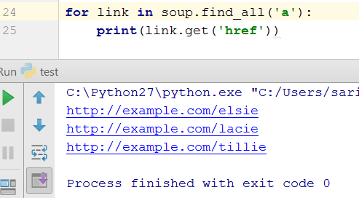
extracting all the URLs found within a page’s <a> tags

Slide 53
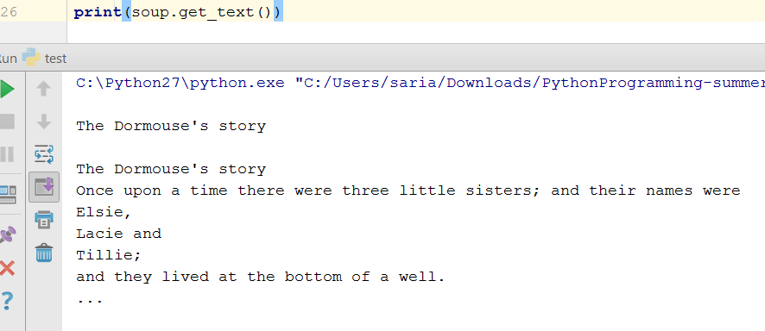
extracting all the text from a page:

Slide 54
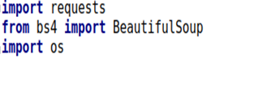
Usecase: Wikipedia
The goal here is to extract all the data related to a keyword from Wikipedia, then save those data in a file.
Libraries to be imported:

Slide 55
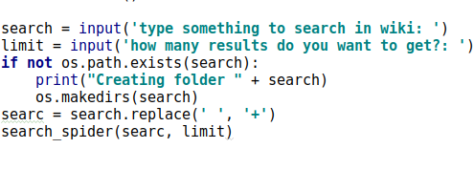
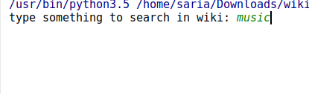
Keyword for searching in the wiki
1. Create a file in the project with the keyword being searched
2. This function call the search api in wiki to find all the pages with the keyword that user has identified

Slide 56
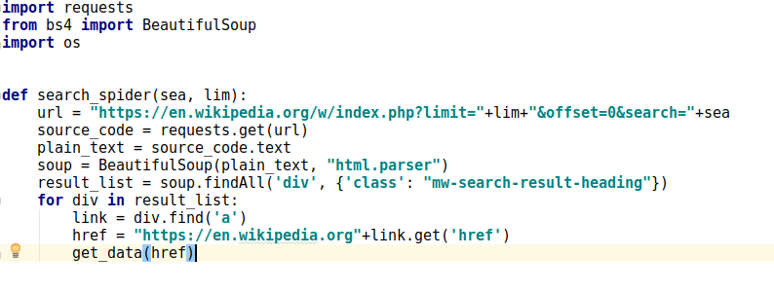
Search the wiki with specified keyword
1. Search the wiki for the keyword
2. Using BeautifulSoap to parse the html
3. Including all the div with this class in the result
4. Analysing the first result

Slide 57
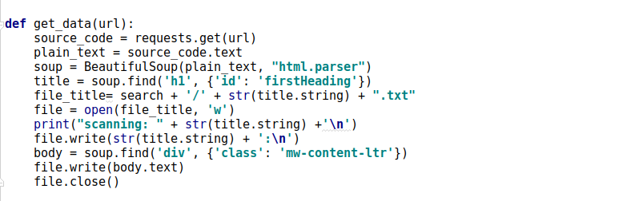
Get the data and save the result in the file
1. Get the url of the result, ex: Barack obama
2. Parse the html page using BeautifulSoap
3. Open the created text file
4. Finding all the dive with this class name
5. Writing the cleaned text in the file

Slide 58
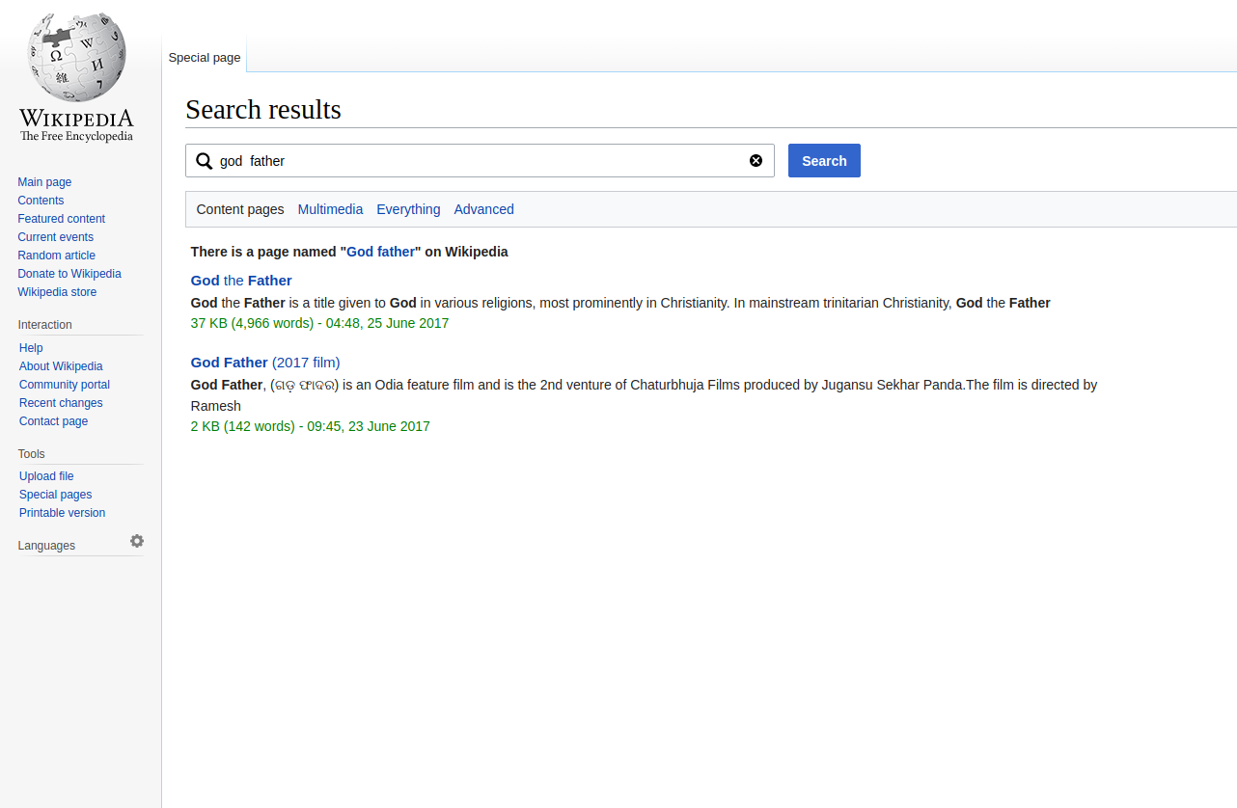
Search in the wiki with keyword “God father”

Slide 59
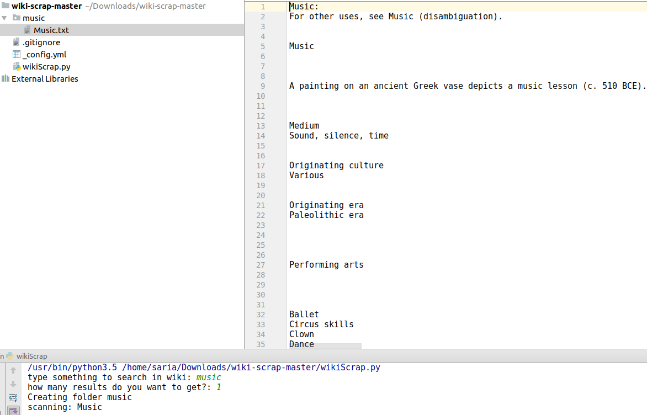
Result

Slide 60
Refrences
https://github.com/saria85/PythonProgramming-summer2017
https://beautiful-soup-4.readthedocs.io/en/latest/
http://www.w3resource.com/pythonexercises/https://www.slideshare.net/milkers/beautiful-soup?qid=64c9989d-94f7-4811-b3102cd7cfcb272e&v=&b=&from_search=6
https://www.learnpython.org/

Slide 61
In class exercise
Write a simple program that parse a wikipage then extract the headers of the page.

Slide 62
Thank you

